Slide 1
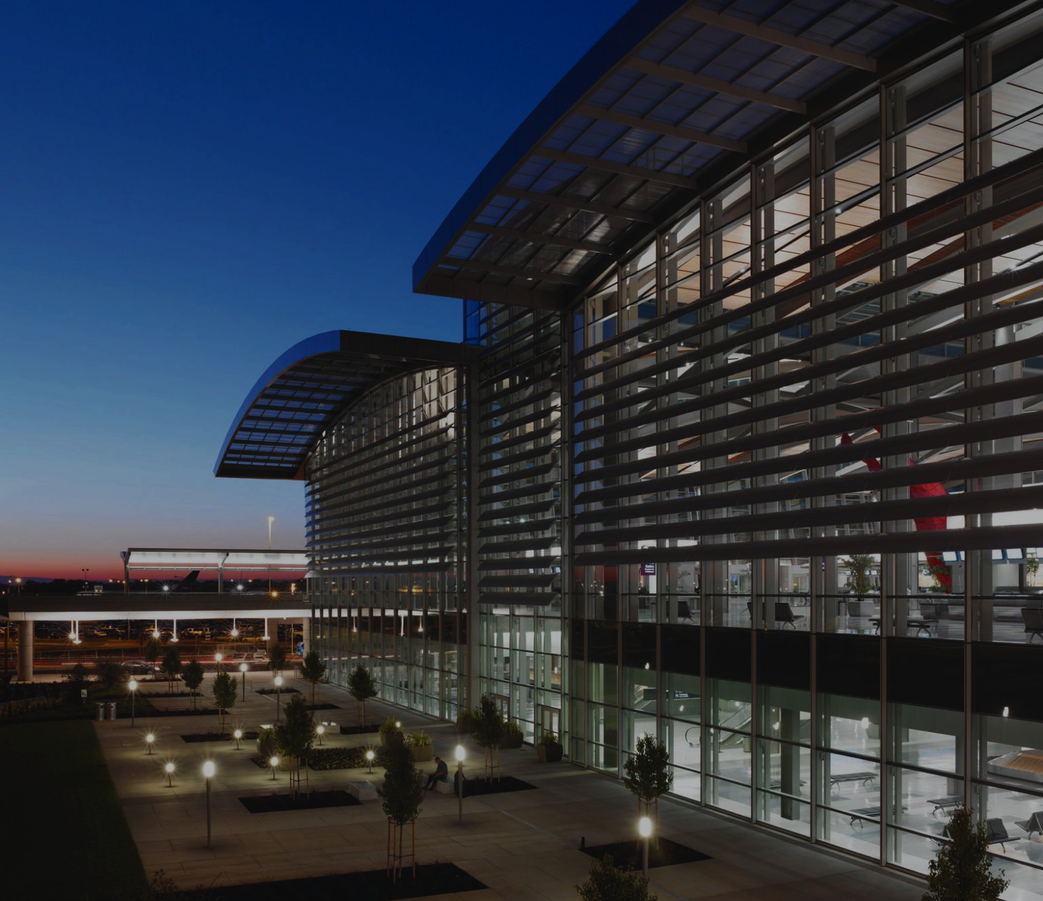
Sacramento County
Department of Airports
Insurance Brokerage Services for Construction Projects
Pre-Proposal Meeting
March 7, 2024

Slide 2
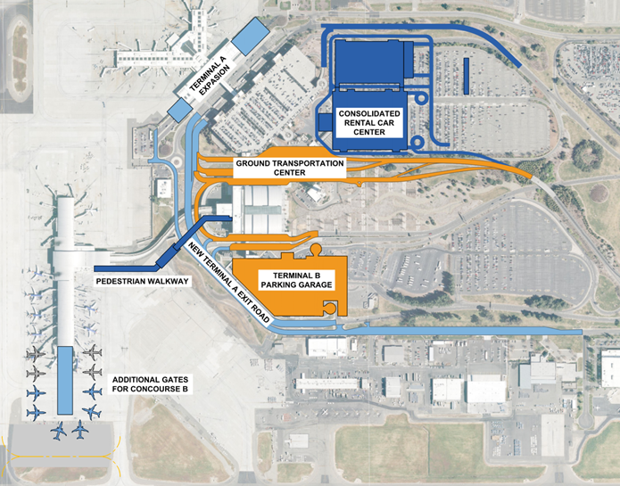
SMForward Overview
7 Major Projects
Terminal B Parking Garage
Pedestrian Walkway
Terminal A Exit Roadway
Consolidated GTC
Concourse B Expansion
Terminal A Expansion
CONRAC

Slide 3
SMForward Contract Methods/Status
Project Phase
Pedestrian Walkway - Awarded
Terminal B Parking Garage - Procurement
Terminal A Exit Roadway - Design
Consolidated GTC - Design
Concourse B Expansion - Programming
Terminal A Expansion - Programming
CONRAC – Delivery Evaluation

Slide 4
Scope of Work
Insurance Program Design & Marketing
OCIP, OPPI, Best Practices
Risk Control & Claims Management
Consultant Bidding Services
Administration Services
Safety Management (OCIP)
Administration, Site Inspections, Training

Slide 5
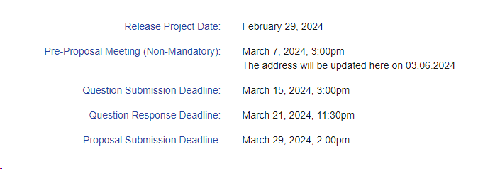
RQ&E Milestones
OCIP Safety Manual: AUGUST 30, 2024

Slide 6
Submittal Requirements
Statement of Qualifications
Attachment 3: Certification of Compliance Form
Attachment 3-1: Tax Delinquency and Felony Convictions Form
Attachment 4: Contractor Identification Form
Audited Financial Statement
Attachment 5: Proposed Fee Schedule Form

Slide 7
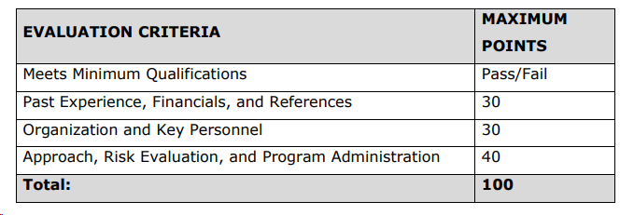
Scoring

Slide 8
Comments Questions

