Slide 1
Developing Relationships with General and Corporate Aviation Tenants
WRAPm 2022

Slide 2
Presenters & Acknowledgements
Today’s Panel:
Anne Baldwin, San Diego County
Phil Bevan, Salt Lake City
Primary Sources:
National Air Transportation Association “The Voice of Aviation Business” “Players for the Same Team”
NBAA-BACE: Engagement Key to Fostering Positive Airport-Tenant Relationships
Forbes Business Council, “How To Build Authentic Business Relationships”

Slide 3
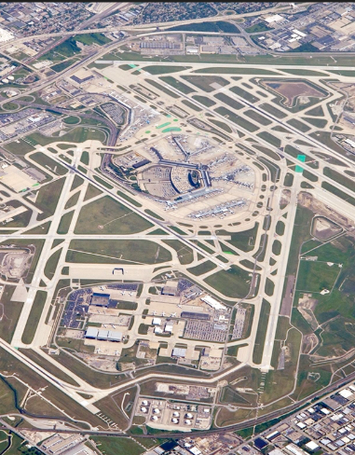
If you have seen one airport….
Notes:
An expression often used in the airport-tenant conversation is, “If you’ve seen one airport, you’ve seen one airport.” Great diversity exists at our nation’s public-use airports and their thousands of fixed base operations. Airports differ in, size, volume, type of fuel, lease terms, capital invested, minimum standards, hours of operation. Every airport has its own unique economy and circumstances. And while it might appear at a national level that a wide variance in charges at airports reflects a lack of diligence by some airport sponsors, actually it is more reflective of the unique circumstances of the individual airport. As airport sponsors, we have a vested interest in the success of our tenants, for example FBOs selling as much fuel as possible in order to reap the benefit of fuel flowage fees.

Slide 4
The Airport-Tenant Relationship
Notes:
There’s no I in team, but there is an airport and an FBO. When it comes to FBOs and airports, an us vs. them relationship benefits no one. It’s time to view these relationships in the context of we, with everyone being part of the same team. Airports and FBOs have a roller coaster relationship. When times are good, relations are harmonious. But when times are bad, the partnership goes sour. But while these relationships can be uncertain at times, they are necessary and both parties have a hand in nurturing and growing them. FBOs provide a long-term business partner seeking to help with the airport’s success and as airport sponsors, it is critical that we see them as such.

Slide 5
What sparks some of the problems that occur?
Notes:
Our corporate and general aviation tenants are privately run, enterprise-driven entities. Airports often look at their tenants in good times and say, "We want a piece of the action.” Yet in the bad times, when those same companies are struggling to keep their doors open, there's not much interest in them at all. Running an FBO is a very tough business to be in. It's very low margin. We need to have enduring relationships with our tenants to ensure that both organizations, the airport sponsor and the tenant, are viable entities. We can't just go and ask for things when we need something. We've always got to be communicating very aggressively. We've got to attend all the opportunities we have to interact directly with our tenants. By doing this, over time, we build trust with one another. It's a heavy lift by both groups, by airports and by the tenants on the airport, to make sure that they're communicating as often as possible and working through issues that are causing friction in the relationship. The best way to do that is not via email, text, or even phone. It's sitting across the table from a colleague that has the same broad interests as you do.

Slide 6
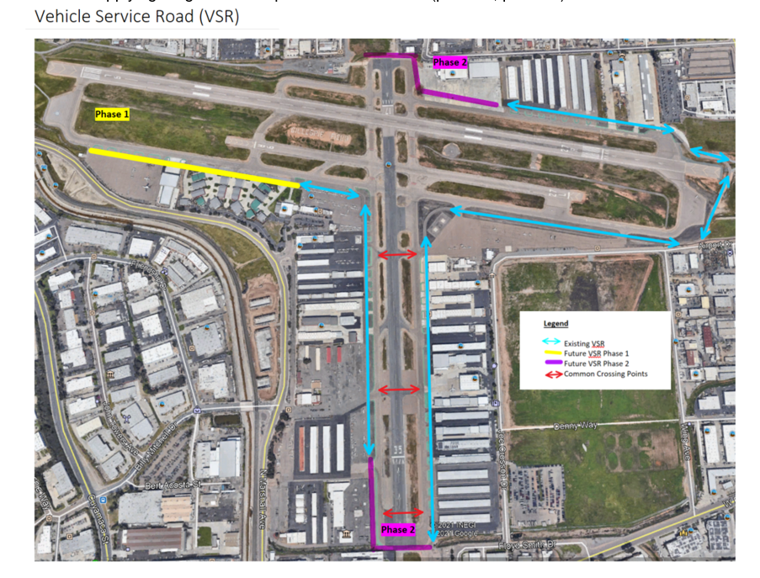
Case Study 1 – Done Wrong
Project meetings with KEY Stakeholders but NOT all stakeholders
Public Advisory Group meetings but NOT specific tenants meeting
Received and acted on input, but did not adequately communicate the results of that input
Notes:
When it comes to long-term capital investment in your airport, all the stakeholders have to be at the table for that to be successful. It’s vital that tenants be part of the process because how these capital improvements or repairs to the airfield are conducted could impact these businesses. It serves us all well to make sure that all views are heard prior to making large decisions.
Basically. what it all comes down to is just really good open communication and participation among all parties involved. It’s not an us vs. them situation. It’s a we. That’s how I would describe a successful relationship between sponsors and tenants.
NOTE: I have a good example of this that I can speak to at this point. (Anne B.)

Slide 7
Case Study 2 – Done Right
Driver’s Training Program
Administrative Citations Program
Notes:
NOTE: I have 2 good examples of this that I can speak to at this point. (Anne B.)

Slide 8
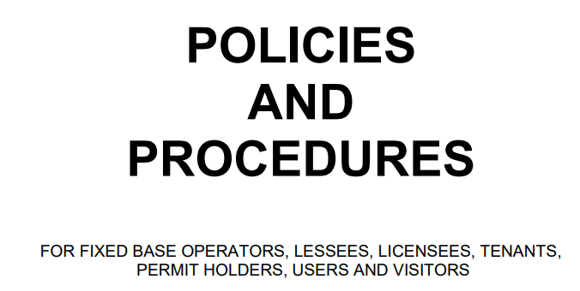
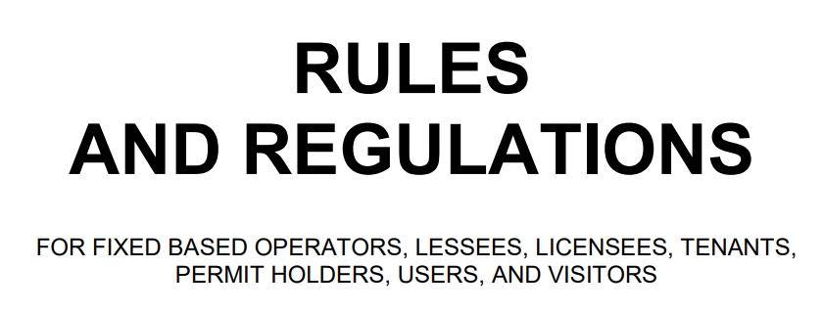
Key Communication - Minimum Standards
Notes:
As one excellent example of when to really engage your tenants, all tenants should be involved in the minimum standards process at airports because that really sets the playing field for private enterprise. We've found when we see some of our tenant members struggle with their relationships, it's because they haven't been engaged in the airport minimum standards process. It's in everyone's best interest to have all the stakeholders at the table when discussing airport minimum standards, whether they're being modified or adding new ones.
Airport sponsors should also establish a dialogue early and can reduce headaches when it comes time to renegotiate leases or expand existing hangars and facilities. By early, we may be talking 1-2 years in advance. It sounds excessive, but the more complicated or controversial the discussion, the longer it’s going to take to come to an agreement. If you have leases that are set to expire even if it’s within five to ten years, start planning now for when it comes time to renegotiate.
NOTE: I have some “war stories” here as well (Anne B.)

Slide 9
How To Build Authentic Business Relationships
Keys to Success
Notes:
You can’t operate an airport or a business without engaging people, and success starts with establishing meaningful connections with others. When you're building relationships with your corporate and general aviation tenants, you should aim to connect with them on a deeper level. How can you show the people you do business with that you genuinely care? Building authentic business relationships starts with recognizing the importance of viewing everyone as a person with their own desires, motives and interests. After this, you can use the following techniques for creating genuine business relationships.

Slide 10
Identify How You Can Provide Additional Value
Find common ground and identify how you can add value with your time, resources, connections or expertise. Along with establishing a cadence of check-ins to connect (like setting reminders), these are all important to building authentic relationships.
It is impossible to have weekly or monthly conversations with all your tenants, but you should try to check in regularly. Express your interest in their business, ask about their issues, and let them know that you are here to help. If you want to keep the relationship strong, make this outreach routine.

Slide 11
Have Excellent Customer Service
Customer service is the No. 1 free strategy for growth and relationship building. Work on perfecting every interaction or moment of truth with your tenants to leave them as raving fans about your airport.

Slide 12
Partner With Your Tenant Businesses
Honor your tenants and show them your appreciation—don’t just speak the words. Add value by making them see how much you care. Support and connect with your airport businesses and promote communication and support between those businesses.

Slide 13
Focus On Mutual Success
Focus on the success of others and be honest. No one wants to work with someone who is in it for themselves. The best business relationships we have happened when we focused on mutual success and trust. We know that when times get tough, we'll be in it together.

Slide 14
Build Trust and Establish Credibility
The key to relationship building is trust and credibility. Authenticity is a given. At your airport, you should treat every single tenant and their projects like your own. Be committed to their success and walk the talk.
If you meet a tenant or organization that might benefit from another connection, make an introduction. That’s good old-fashioned networking. What goes around, comes around.

Slide 15
Focus on Relational Value, Not Transactional Value
Cultivate your network and relationships each day. Don't approach your tenants in a transactional nature. Meet with them or call periodically. Get to know their needs, values and what drives them. Ask yourself, "How can I be of service and value to them?" Remember, it isn't about you but about them.
They will remember how you made them feel.

Slide 16
Treat Your Tenants Like Friends and Family
People work better with people they like. Treat your corporate and general aviation tenants like you would treat your friends and family. Be yourself, be vulnerable, and show a personal interest in them and their business, in addition to the business value that you already offer.

Slide 17
Try to Put Your Tenants First
Try to put your tenants first even if it costs you to do so in the short run. In the long run, your tenants will remember what you did, and you putting them first will pay off in relationship value over the long term.

Slide 18
Offer Help Before You Ask for Help
Building relationships with your aviation tenants doesn’t mean reaching out only when you need something. If the only time you ever contact a tenant is when you have an issue to address, your gesture won’t seem authentic.
Spend time figuring out how you can help your on-airport businesses. What value or ideas can you offer to spark the conversation?

Slide 19
And Finally…Ask for Feedback
Instead of assuming your corporate and general aviation tenants are happy, ask! Open communication is a basic component of any relationship. When you ask your tenants how they feel, and whether they believe you are communicating effectively and honestly, you promote a two-way conversation that can uncover areas for improvement.

